Slide 1

CHAPTER 10
GRAPHS AND TREES
Copyright © Cengage Learning. All rights reserved.

Slide 2
SECTION 10.3
Matrix Representations
of Graphs
Copyright © Cengage Learning. All rights reserved.

Slide 3
Matrix Representations of Graphs
How can graphs be represented inside a computer? It happens that all the information needed to specify a graph can be conveyed by a structure called a matrix, and matrices (matrices is the plural of matrix) are easy to represent inside computers.
This section contains some basic definitions about matrices and matrix operations, a description of the relation between graphs and matrices, and some applications.

Slide 4
Matrices

Slide 5
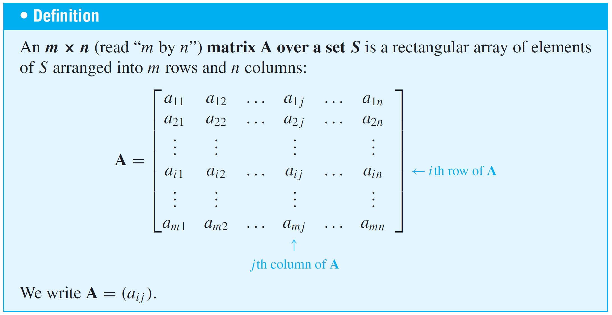
Matrices
Matrices are two-dimensional analogues of sequences. They are also called two-dimensional arrays.

Slide 6
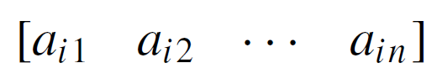
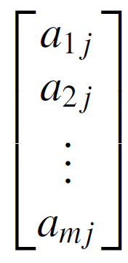
Matrices
The ith row of A is
and the jth column of A is
The entry a_{ij} in the ith row and jth column of A is called the
i jth entry of A. An m × n matrix is said to have size m × n.

Slide 7
Matrices
If A and B are matrices, then A = B if, and only if, A and B have the same size and the corresponding entries of A and B are all equal; that is,
A matrix for which the numbers of rows and columns are equal is called a square matrix.

Slide 8
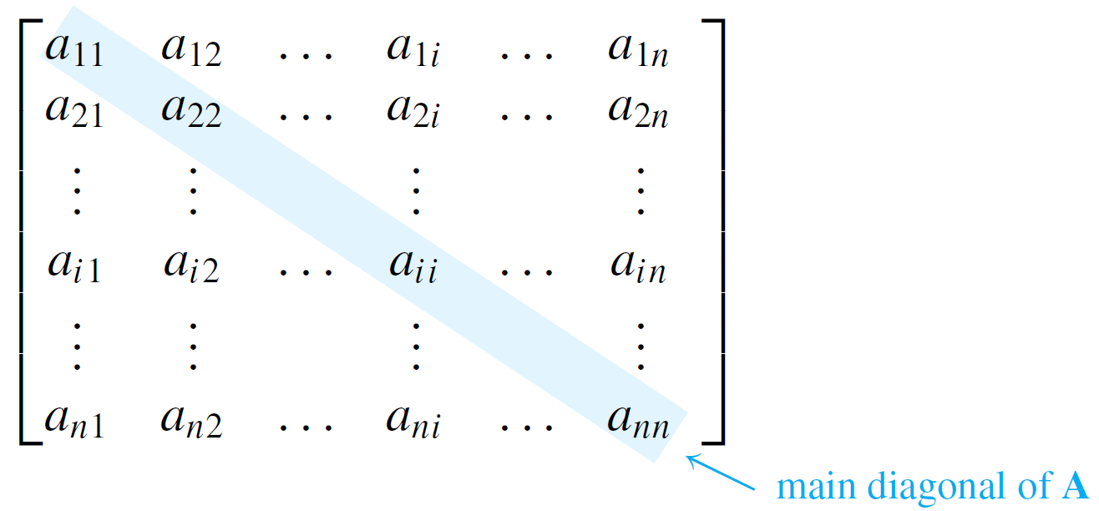
Matrices
If A is a square matrix of size n × n, then the main diagonal of A consists of all the entries a₁₁, a₂₂, . . . , a_{nn}:

Slide 9
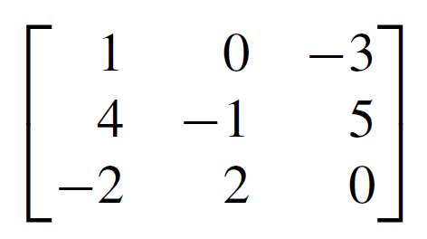
Example 1 – Matrix Terminology
The following is a 3 × 3 matrix over the set of integers.
a. What is the entry in row 2, column 3?
b. What is the second column of A?
c. What are the entries in the main diagonal of A?

Slide 10
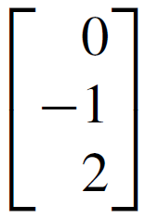
Example 1 – Solution
a. 5
b.
c. 1, –1 and 0

Slide 11
Matrices and Directed Graphs

Slide 12
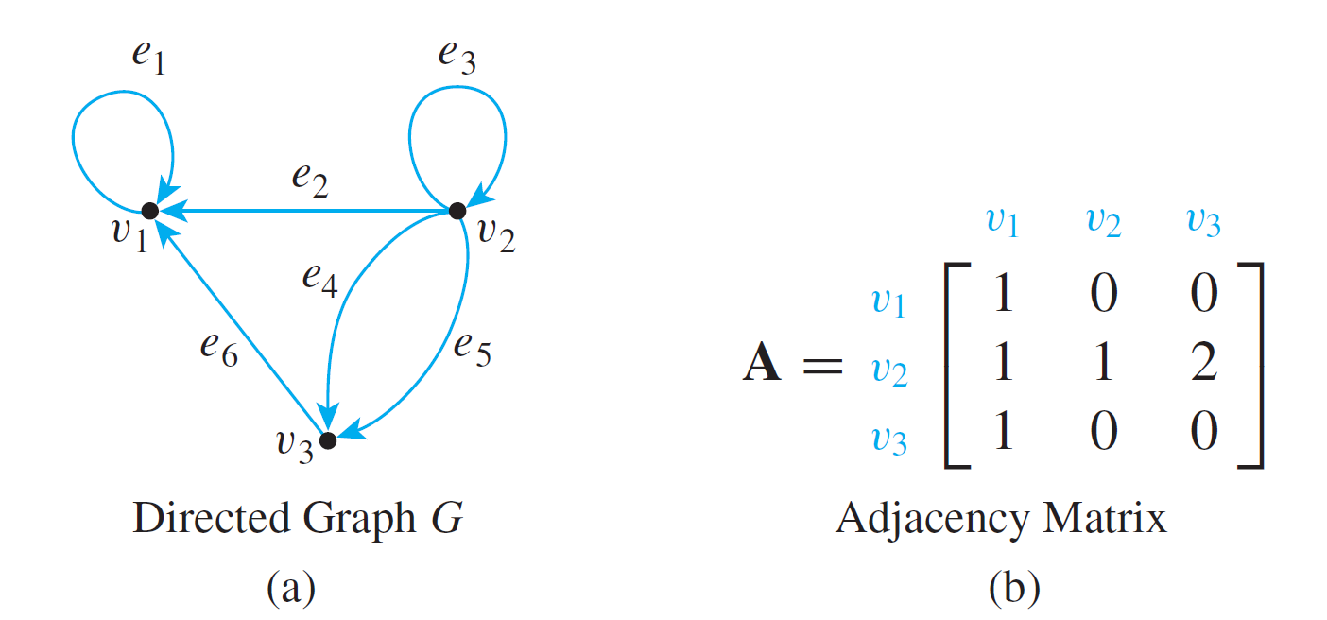
Matrices and Directed Graphs
Consider the directed graph shown in Figure 10.3.1.
A Directed Graph and Its Adjacency Matrix
Figure 10.3.1

Slide 13
Matrices and Directed Graphs
This graph can be represented by the matrix A = (a_{i j}) for which a_{i j} = the number of arrows from v_{i} to v_{j}, for all i = 1, 2, 3 and j = 1, 2, 3.
Thus a₁₁ = 1 because there is one arrow from v₁ to v₁,
a₁₂ = 0 because there is no arrow from v₁ to v₂, a₂₃ = 2 because there are two arrows from v₂ to v₃, and so forth.
A is called the adjacency matrix of the directed graph.
For convenient reference, the rows and columns of A are often labeled with the vertices of the graph G.

Slide 14
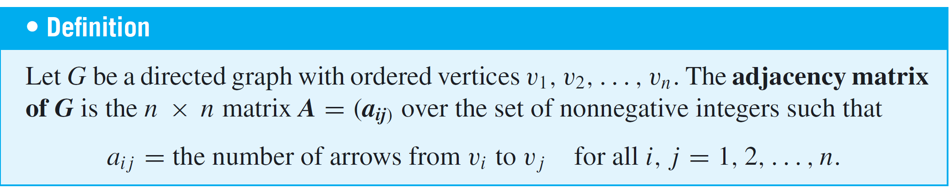
Matrices and Directed Graphs
Note that nonzero entries along the main diagonal of an adjacency matrix indicate the presence of loops, and entries larger than 1 correspond to parallel edges.
Moreover, if the vertices of a directed graph are reordered, then the entries in the rows and columns of the corresponding adjacency matrix are moved around.

Slide 15
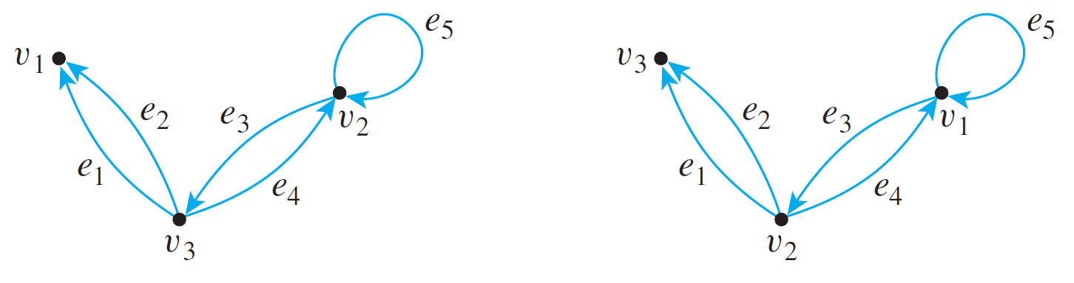
Example 2 – The Adjacency Matrix of a Graph
The two directed graphs shown below differ only in the ordering of their vertices. Find their adjacency matrices.
(a)
(b)

Slide 16
Example 2 – Solution
Since both graphs have three vertices, both adjacency matrices are 3 × 3 matrices.
For (a), all entries in the first row are 0 since there are no arrows from v₁ to any other vertex.
For (b), the first two entries in the first row are 1 and the third entry is 0 since from v₁ there are single arrows to v₁ and to v₂ and no arrows to v₃.

Slide 17
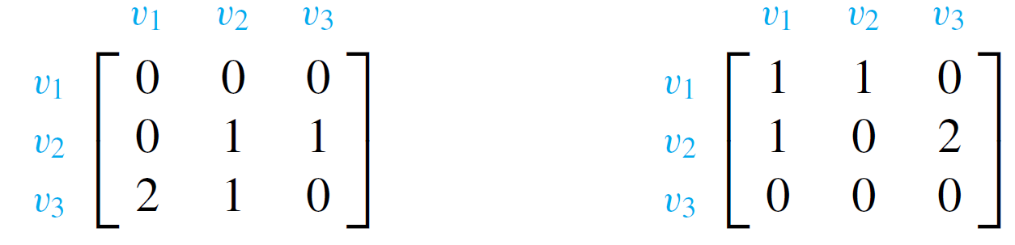
Example 2 – Solution
cont’d
Continuing the analysis in this way, you obtain the following two adjacency matrices:
(a)
(b)

Slide 18
Matrices and Directed Graphs
If you are given a square matrix with nonnegative integer entries, you can construct a directed graph with that matrix as its adjacency matrix.
However, the matrix does not tell you how to label the edges, so the directed graph is not uniquely determined.

Slide 19
Matrices and Undirected Graphs

Slide 20
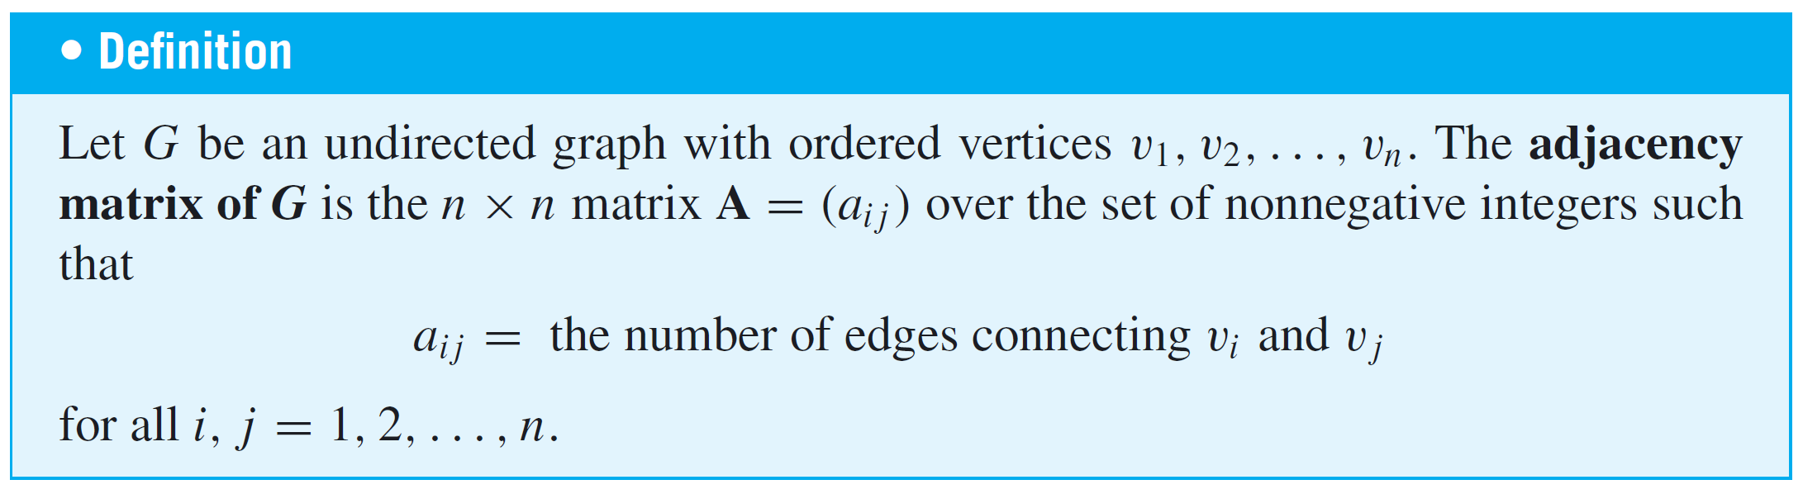
Matrices and Undirected Graphs
Once you know how to associate a matrix with a directed graph, the definition of the matrix corresponding to an undirected graph should seem natural to you.
As before, you must order the vertices of the graph, but in this case you simply set the i j th entry of the adjacency matrix equal to the number of edges connecting the i th and j th vertices of the graph.

Slide 21
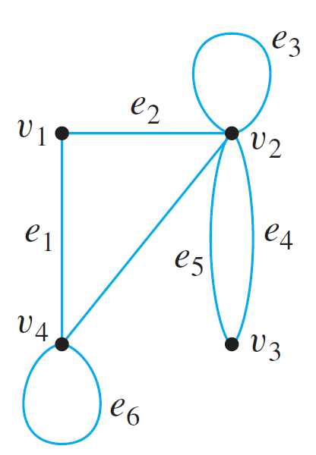
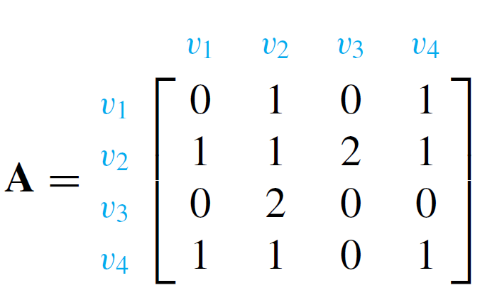
Example 4 – Finding the Adjacency Matrix of a Graph
Find the adjacency matrix for the graph G shown below.
Solution:

Slide 22
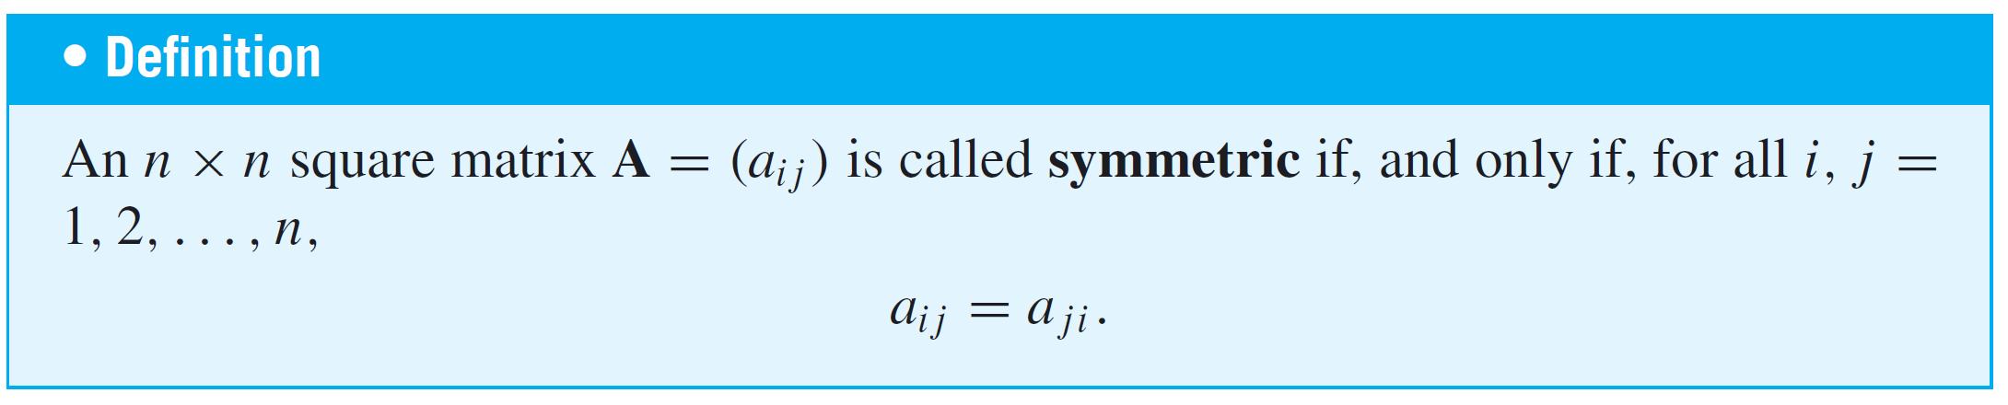
Matrices and Undirected Graphs
Note that if the matrix A = (a_{i j}) in Example 4 is flipped across its main diagonal, it looks the same: a_{i j} = a_{j i}, for i,
j = 1, 2, . . . , n. Such a matrix is said to be symmetric.
It is easy to see that the matrix of any undirected graph is symmetric since it is always the case that the number of edges joining v_{i} and v_{j} equals the number of edges joining v_{j} and v_{i} for all i, j = 1, 2, . . . , n.

Slide 23
Matrices and Connected
Components

Slide 24
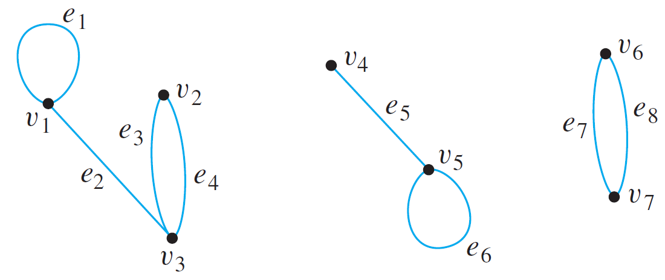
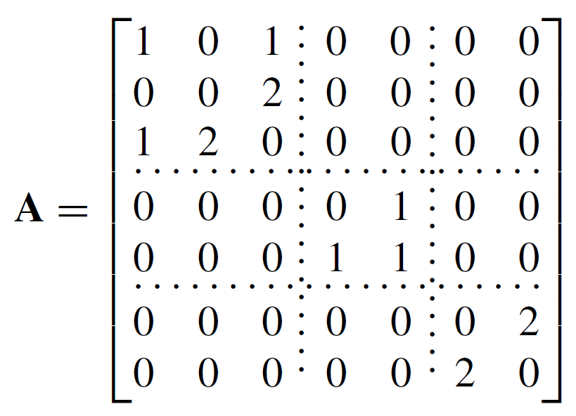
Matrices and Connected Components
Consider a graph G, as shown below, that consists of several connected components.
The adjacency matrix of G is

Slide 25
Matrices and Connected Components
As you can see, A consists of square matrix blocks (of different sizes) down its diagonal and blocks of 0’s everywhere else.
The reason is that vertices in each connected component share no edges with vertices in other connected components.
For instance, since v₁, v₂, and v₃ share no edges with v₄, v₅, v₆, or v₇, all entries in the top three rows to the right of the third column are 0 and all entries in the left three columns below the third row are also 0.
Sometimes matrices whose entries are all 0’s are themselves denoted 0.

Slide 26
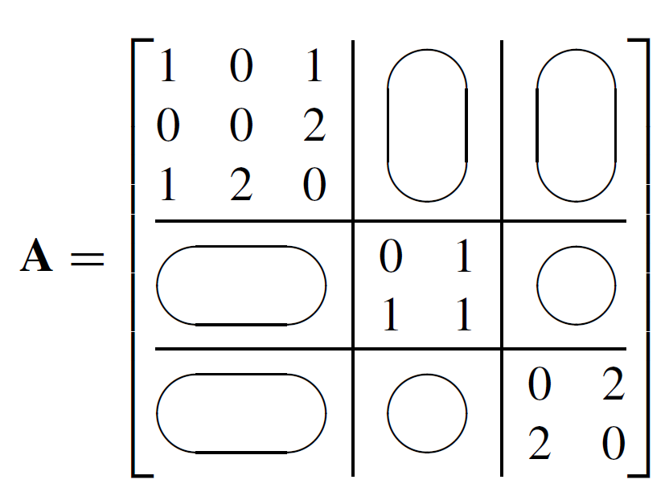
Matrices and Connected Components
If this convention is followed here, A is written as

Slide 27
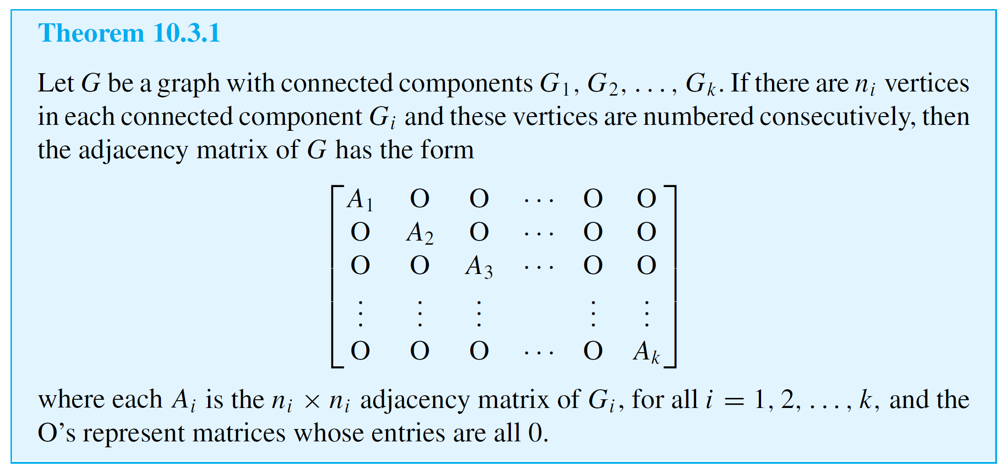
Matrices and Connected Components
The previous reasoning can be generalized to prove the following theorem:

Slide 28
Matrix Multiplication

Slide 29
Matrix Multiplication
Matrix multiplication is an enormously useful operation that arises in many contexts, including the investigation of walks in graphs.
Although matrix multiplication can be defined in quite abstract settings, the definition for matrices whose entries are real numbers will be sufficient for our applications.
The product of two matrices is built up of scalar or dot products of their individual rows and columns.

Slide 30
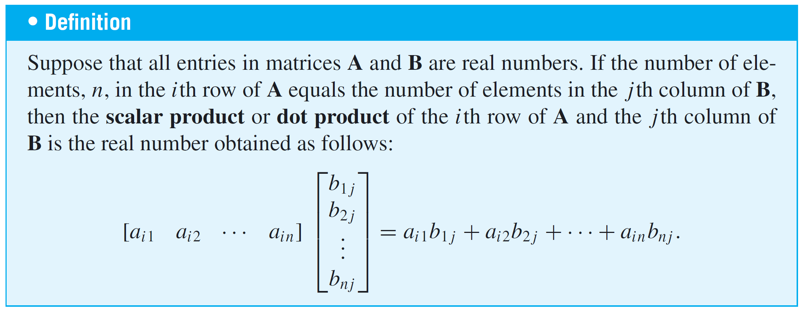
Matrix Multiplication
More generally, if A and B are matrices whose entries are real numbers and if A and B have compatible sizes in the sense that the number of columns of A equals the number of rows of B, then the product AB is defined.

Slide 31
Matrix Multiplication
It is the matrix whose i j th entry is the scalar product of the
i th row of A times the j th column of B, for all possible values of i and j.

Slide 32
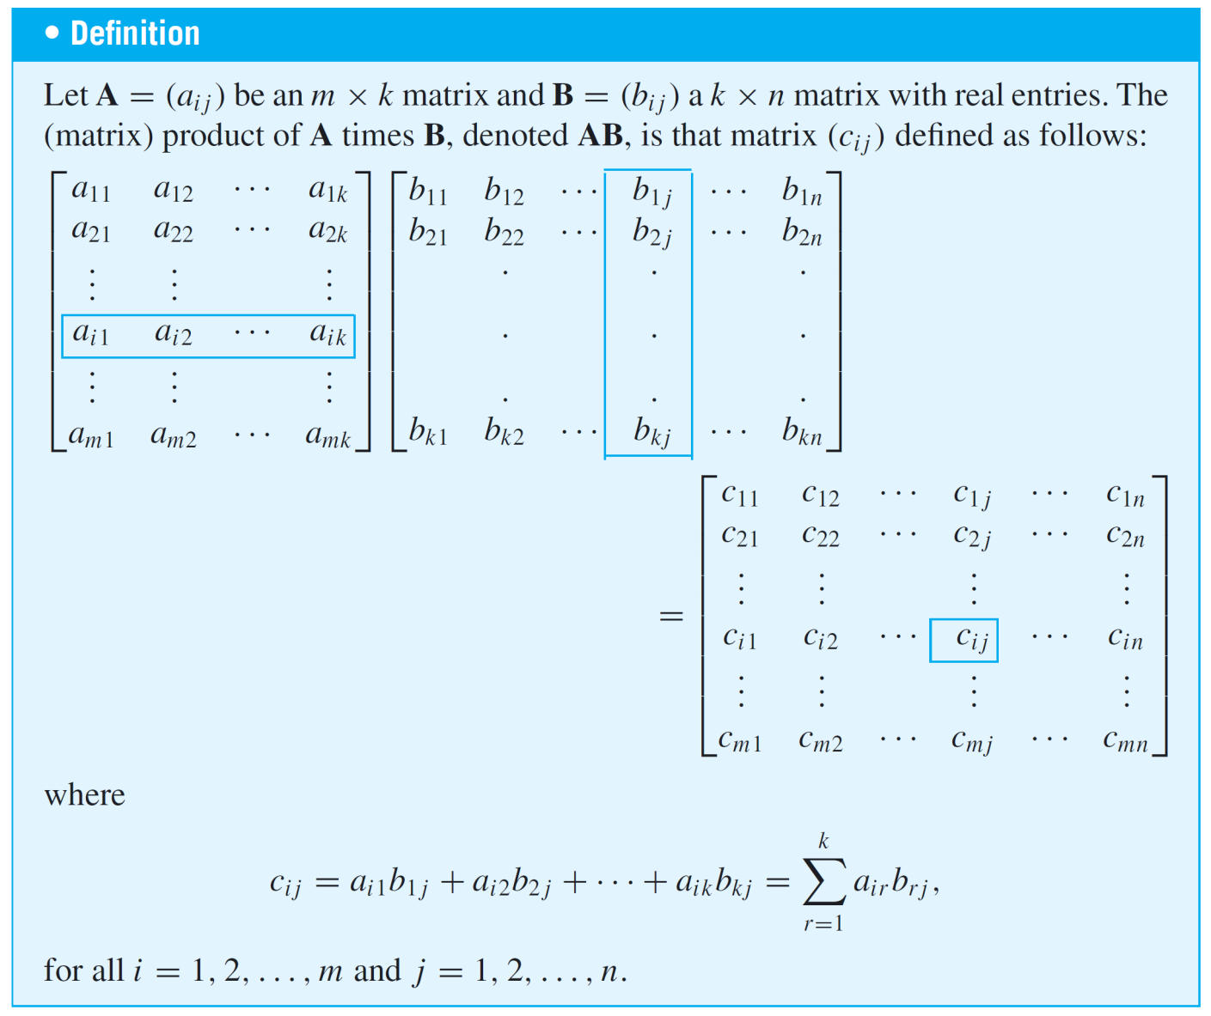
Matrix Multiplication

Slide 33
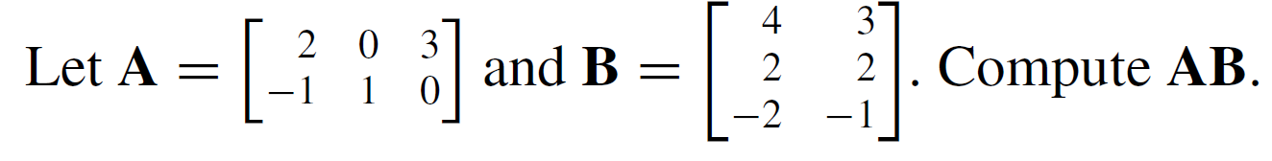
Example 7 – Computing a Matrix Product
Solution:
A has size 2 × 3 and B has size 3 × 2, so the number of columns of A equals the number of rows of B and the matrix product of A and B can be computed.

Slide 34
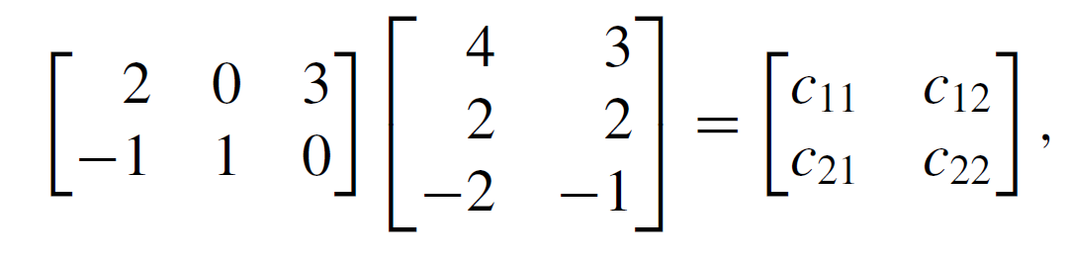
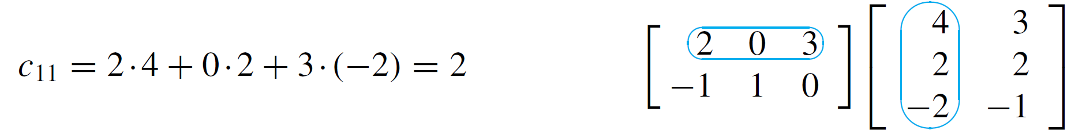
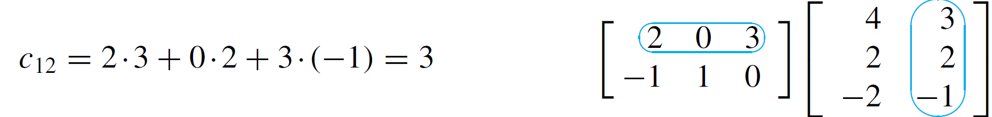
Example 7 – Solution
cont’d
Then
where

Slide 35
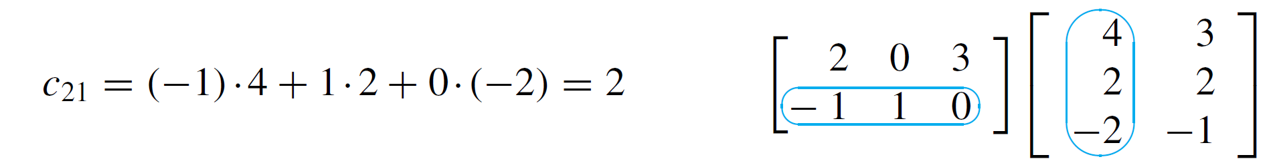
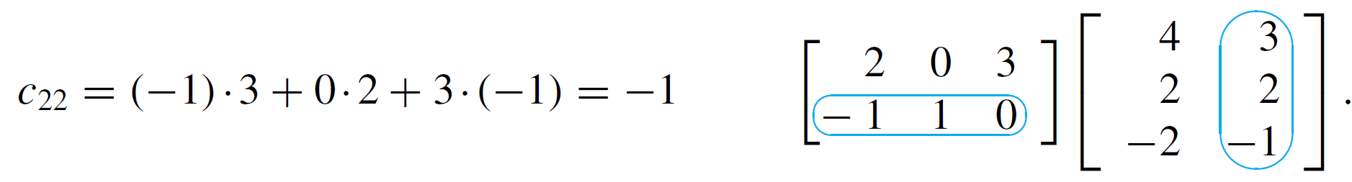
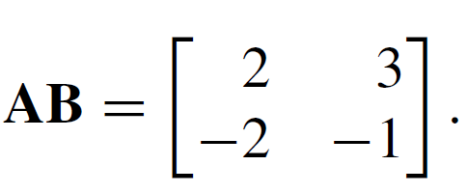
Example 7 – Solution
cont’d
Hence

Slide 36
Matrix Multiplication
Matrix multiplication is both similar to and different from multiplication of real numbers.
One difference is that although the product of any two numbers can be formed, only matrices with compatible sizes can be multiplied.
Also, multiplication of real numbers is commutative (for all real numbers a and b, ab = ba), whereas matrix multiplication is not.

Slide 37
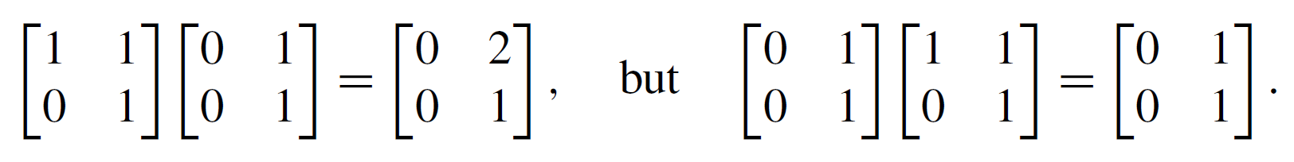
Matrix Multiplication
For instance,
On the other hand, both real number and matrix multiplications are associative ((ab)c = a(bc), for all elements a, b, and c for which the products are defined).
As far as multiplicative identities are concerned, there are both similarities and differences between real numbers and matrices.

Slide 38
Matrix Multiplication
You know that the number 1 acts as a multiplicative
identity for products of real numbers.
It turns out that there are certain matrices, called identity matrices, that act as multiplicative identities for certain matrix products.

Slide 39
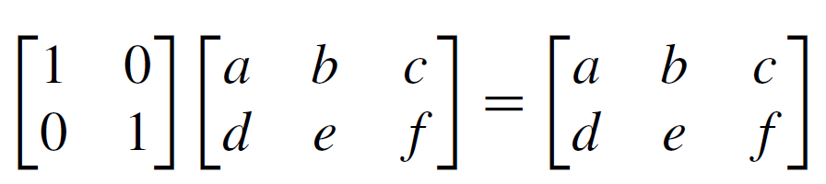
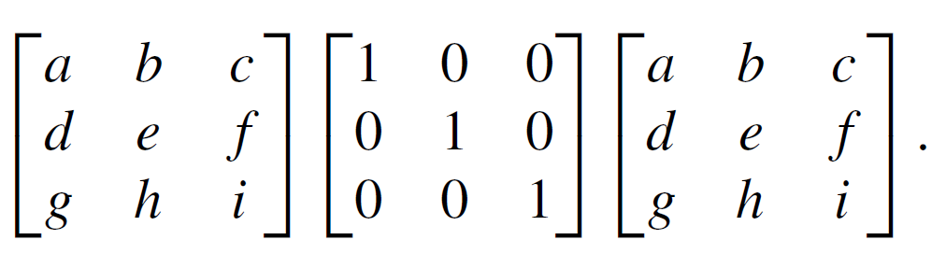
Matrix Multiplication
For instance, mentally perform the following matrix multiplications to check that for any real numbers a, b, c, d, e, f, g, h and i,
and

Slide 40
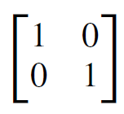
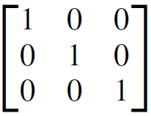
Matrix Multiplication
These computations show that acts as an identity on
the left side for multiplication with 2 × 3 matrices and that
acts as an identity on the right side for multiplication
with 3 × 3 matrices.

Slide 41
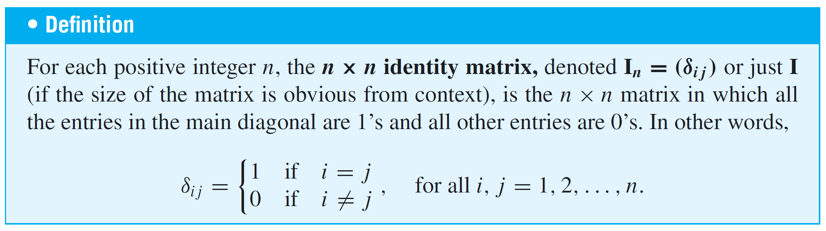
Matrix Multiplication
Note that cannot act as an identity on the right side for
multiplication with 2 × 3 matrices because the sizes are not compatible.
The German mathematician Leopold Kronecker introduced the symbol δ_{i j} to make matrix computations more convenient. In his honor, this symbol is called the Kronecker delta.

Slide 42
Example 9 – An Identity Matrix Acts as an Identity
Prove that if A is any m × n matrix and I is the n × n identity matrix, then AI = A.
Proof:
Let A be any n × n matrix and let a_{i j} be the i j th entry of A for all integers i = 1, 2, . . . ,m and j = 1, 2, . . . , n. Consider the product AI, where I is the n × n identity matrix.

Slide 43
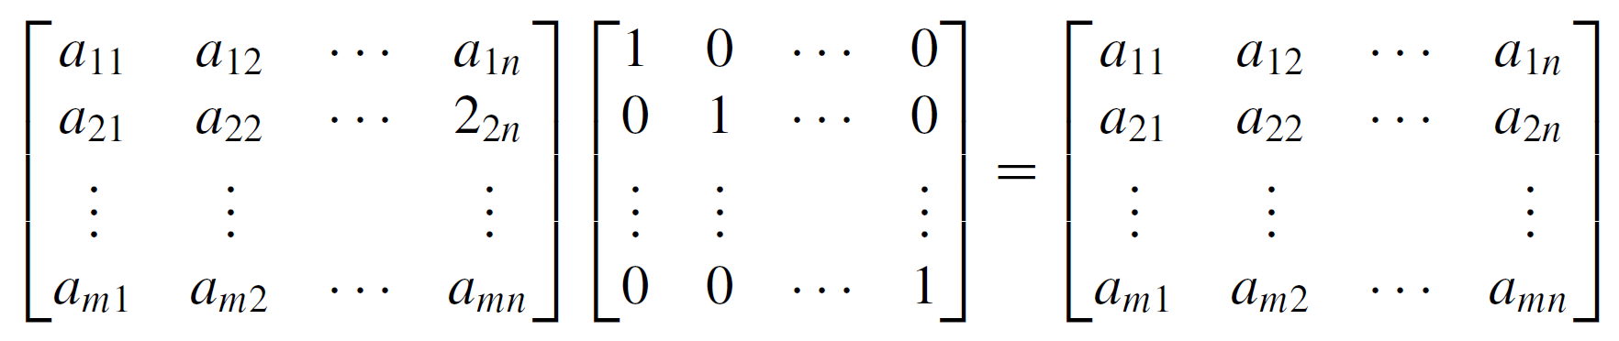

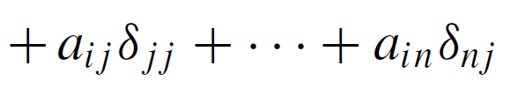
Example 9 – An Identity Matrix Acts as an Identity
cont’d
Observe that
because

Slide 44


Example 9 – An Identity Matrix Acts as an Identity
cont’d
Thus AI = A, as was to be shown.

Slide 45
Matrix Multiplication
There are also similarities and differences between real numbers and matrices with respect to the computation of powers.
Any number can be raised to a nonnegative integer power, but a matrix can be multiplied by itself only if it has the same number of rows as columns.
As for real numbers, however, the definition of matrix powers is recursive.
Just as any number to the zero power is defined to be 1, so any n × n matrix to the zero power is defined to be the
n × n identity matrix.

Slide 46
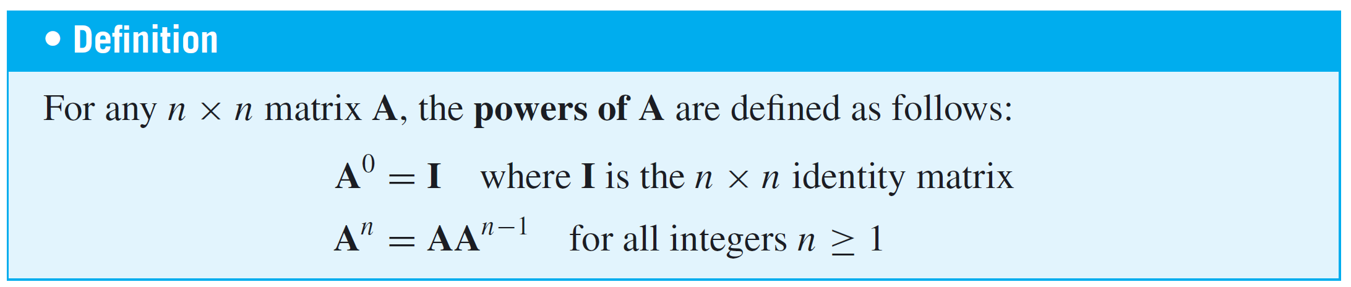
Matrix Multiplication
The nth power of an n × n matrix A is defined to be the product of A with its (n – 1)st power.

Slide 47
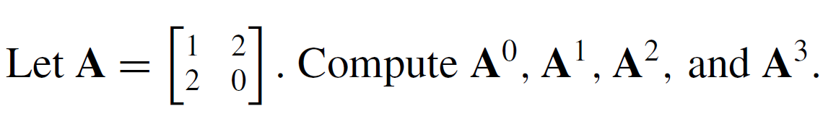
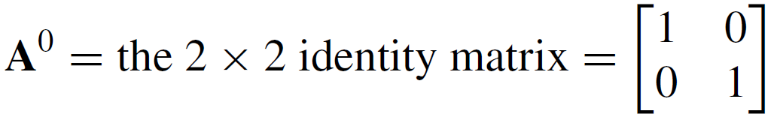

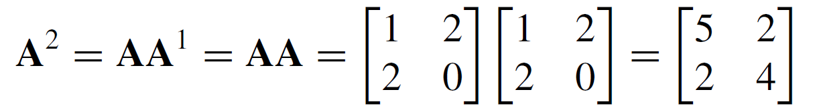
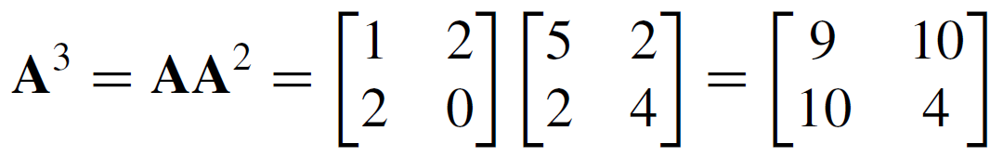
Example 10 – Powers of a Matrix
Solution:

Slide 48
Counting Walks of Length N

Slide 49
Counting Walks of Length N
A walk in a graph consists of an alternating sequence of vertices and edges.
If repeated edges are counted each time they occur, then the number of edges in the sequence is called the length of the walk.
For instance, the walk v₂e₃v₃e₄v₂e₂v₂e₃v₃ has length 4 (counting e₃ twice).

Slide 50
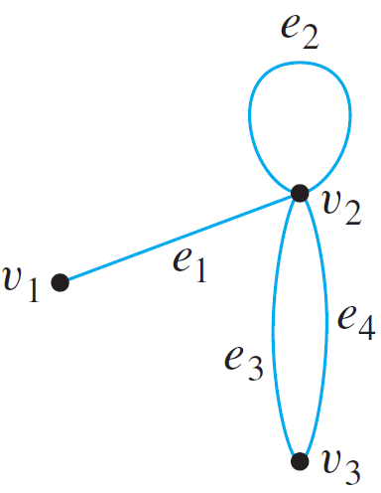
Counting Walks of Length N
Consider the following graph G:
How many distinct walks of length 2 connect v₂ and v₂?

Slide 51
Counting Walks of Length N
You can list the possibilities systematically as follows: From v₁, the first edge of the walk must go to some vertex of G: v₁, v₂, or v₃. There is one walk of length 2 from v₂ to v₂ that starts by going from v₂ to v₁:
v₂e₁v₁e₁v₂.
There is one walk of length 2 from v₂ to v₂ that starts by going from v₂ to v₂:
v₂e₂v₂e₂v₂.

Slide 52
Counting Walks of Length N
And there are four walks of length 2 from v₂ to v₂ that start by going from v₂ to v₃:
v₂e₃v₃e₄v₂,
v₂e₄v₃e₃v₂,
v₂e₃v₃e₃v₂,
v₂e₄v₃e₄v₂.
Thus the answer is six.

Slide 53
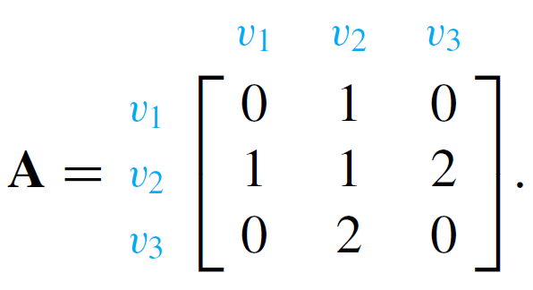
Counting Walks of Length N
The general question of finding the number of walks that have a given length and connect two particular vertices of a graph can easily be answered using matrix multiplication.
Consider the adjacency matrix A of the graph G.

Slide 54
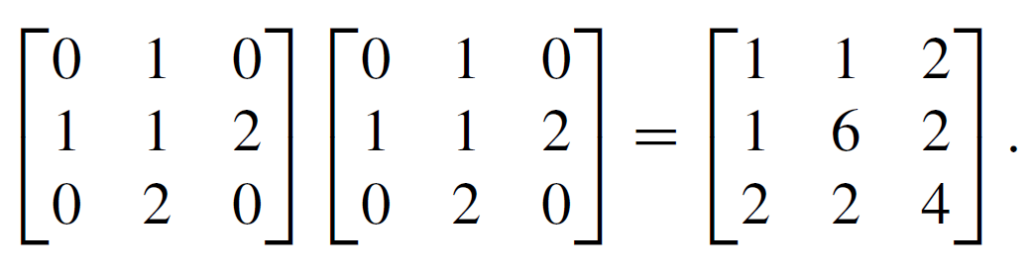
Counting Walks of Length N
Compute A² as follows:
Note that the entry in the second row and the second column is 6, which equals the number of walks of length 2 from v₂ to v₂.

Slide 55
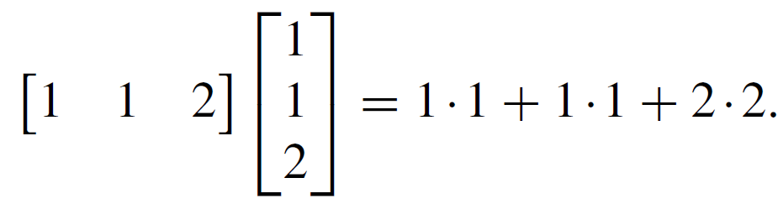
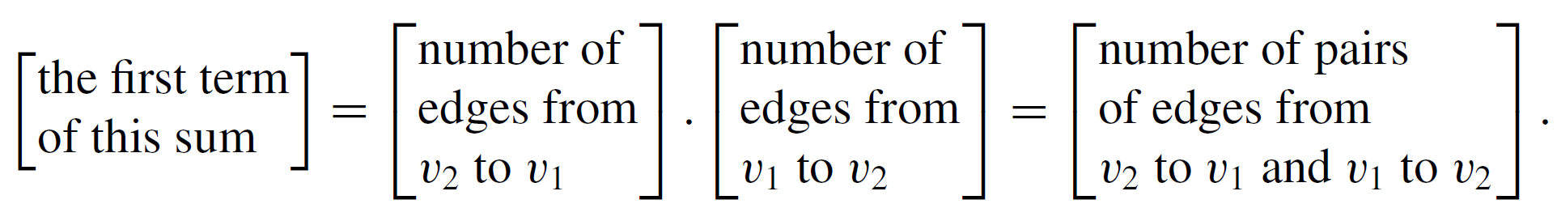
Counting Walks of Length N
This is no accident! To compute a₂₂, you multiply the second row of A times the second column of A to obtain a sum of three terms:
Observe that

Slide 56
Counting Walks of Length N
Now consider the ith term of this sum, for each i = 1, 2, and 3. It equals the number of edges from v₂ to v_{i} times the number of edges from v_{i} to v₂.
By the multiplication rule this equals the number of pairs of edges from v₂ to v_{i} and from v_{i} back to v₂.
But this equals the number of walks of length 2 that start and end at v₂ and pass through v_{i}.

Slide 57
Counting Walks of Length N
Since this analysis holds for each term of the sum for i = 1, 2, and 3, the sum as a whole equals the total number of walks of length 2 that start and end at v₂:
1·1 + 1·1 + 2·2 = 1 + 1 + 4 = 6.
More generally, if A is the adjacency matrix of a graph G, the i j th entry of A² equals the number of walks of length 2 connecting the i th vertex to the j th vertex of G.

Slide 58
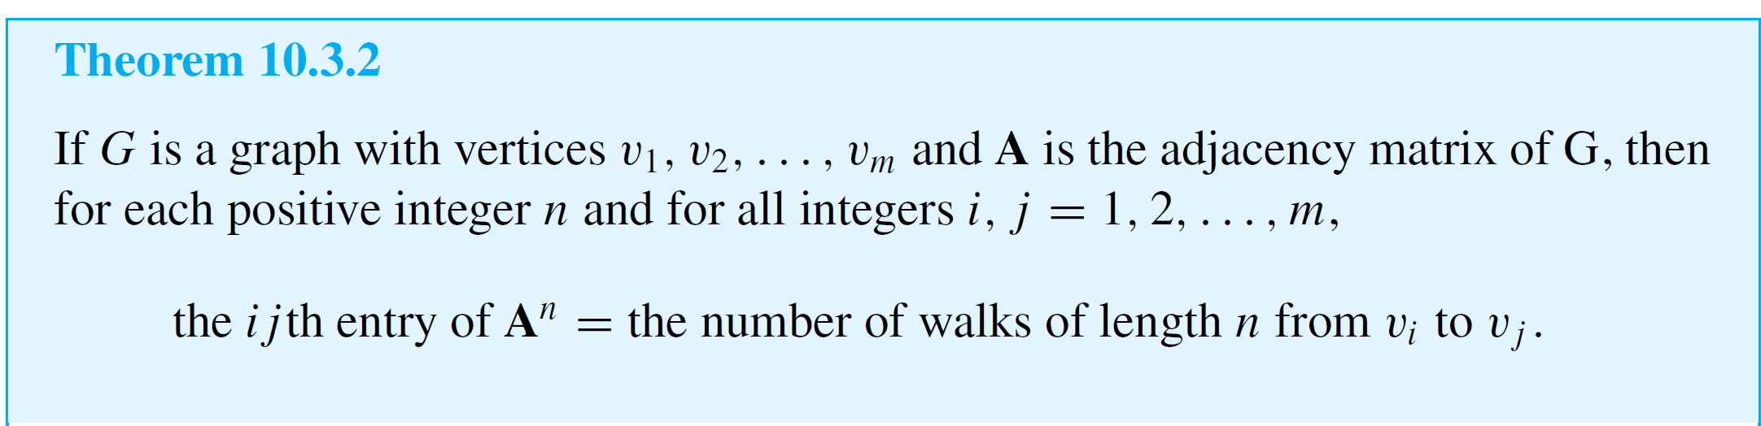
Counting Walks of Length N
Even more generally, if n is any positive integer, the i j th entry of A^{n} equals the number of walks of length n connecting the i th and the j th vertices of G.

